Slide 1
Personal Budget Tracker
Tolani Oke-Steve (200429404)
Dmytro Stepaniuk (200426341)
Grant Zhao (200484531)
Software Testing and Validation (ENSE 375)

Slide 2
Agenda
Introduction
Problem Definition
Design Requirements
Solutions
Testing and Demonstration
Project Management
Conclusion and Future Scope

Slide 3
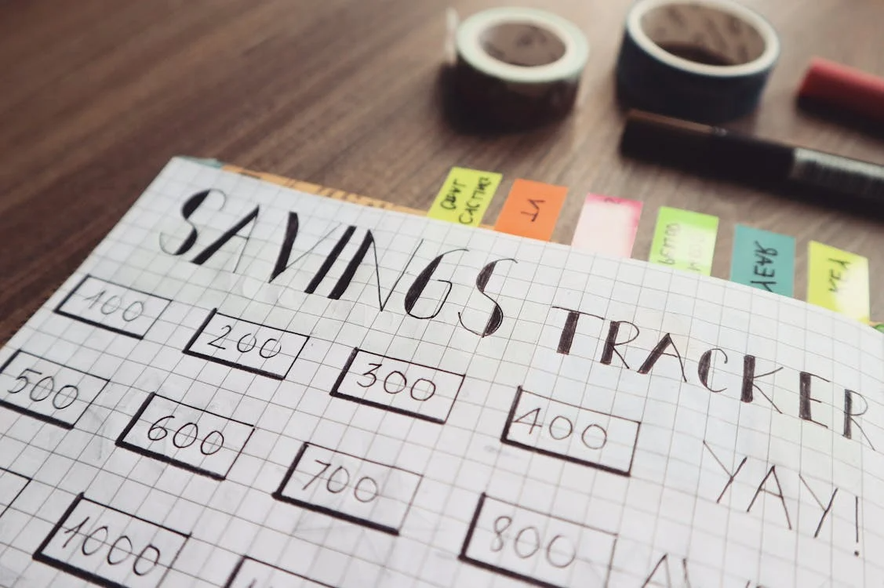
Introduction
The Personal Budget Tracker is a software application made to support personal financial management. Its primary goal is to provide users with helpful and clear summaries of their income and spending. This information can be accessed easily, encouraging careful budgeting and financial decisions. This report presents a comprehensive overview of the design and development of Budget Tracker, outlining the planning going into the project, the implementation for that planning and the testing methods to evaluate the program.

Slide 4


Problem Definition
Problem
Students & young professionals struggle to manage personal finances
Lack of clarity on income, expenses, and habits → overspending & stress
Target Users
Students
Early-career professionals
Individuals seeking better financial literacy with minimal effort
Why It Matters
Financial management is a key life skill
Impacts mental health, stability, and future planning
Promotes responsible spending & saving
Proposed Solution
User-friendly budgeting app to:
Input income & expenses
Categorize transactions
View visual summaries (pie charts, bar graphs)
Focus on simplicity, clarity, accuracy

Slide 5
Design Requirements
Functions
Track Spending: Enable users to input and visualize their weekly and monthly spending
Track Income: Allow users to input and update their monthly income
Set budget Goals: This budget tracker will give users the opportunity to set spending limits and saving goals on specific categories
Generate visual summaries: Create pie charts, bar graphs and other visualization tools to help users illustrate their financial health
Display budget Overview: Show users a clear overview of their financial behavior.
Protect user information: Ensures users data are protected through encryption and authentication.
Categorize spending: Sort expenses and income into custom categories based on type.
Objectives
Secure: The application should protect user data and privacy through strong authentication
Reliable: The application should consistently perform accurate calculations and store user data securely
Efficient: With the personal budget tracker users should be able to manage their finances with minimal effort
Easy to use: The application should be intuitive and easy to use for users
Accurate: The application should ensure correct recording and analysis of spending and income
Responsive: Quick reaction to user inputs and updating visuals quickly are a priority for this application.
Flexible: This application should allow users to customize their financial goals to suit their specific needs.
Informative: This application should provide meaningful insights to users' financial behavior.

Slide 6
Design Requirements
Constraints
1. Economic Factors
The solution must be cost-effective for end users, with no hidden costs.
The software should assist users in managing finances without requiring premium features or external purchases.
2. Reliability
The application must ensure accurate calculations and stable performance.
It will be tested using:
Unit testing
Boundary value testing
Equivalence class testing
3. Ethics
User data must be handled securely and respectfully.
No sensitive data should be stored or shared beyond its intended use.
4. Societal Impact
The application promotes financial literacy and responsible spending.
It supports individual financial well-being, contributing positively to broader societal stability.

Slide 7
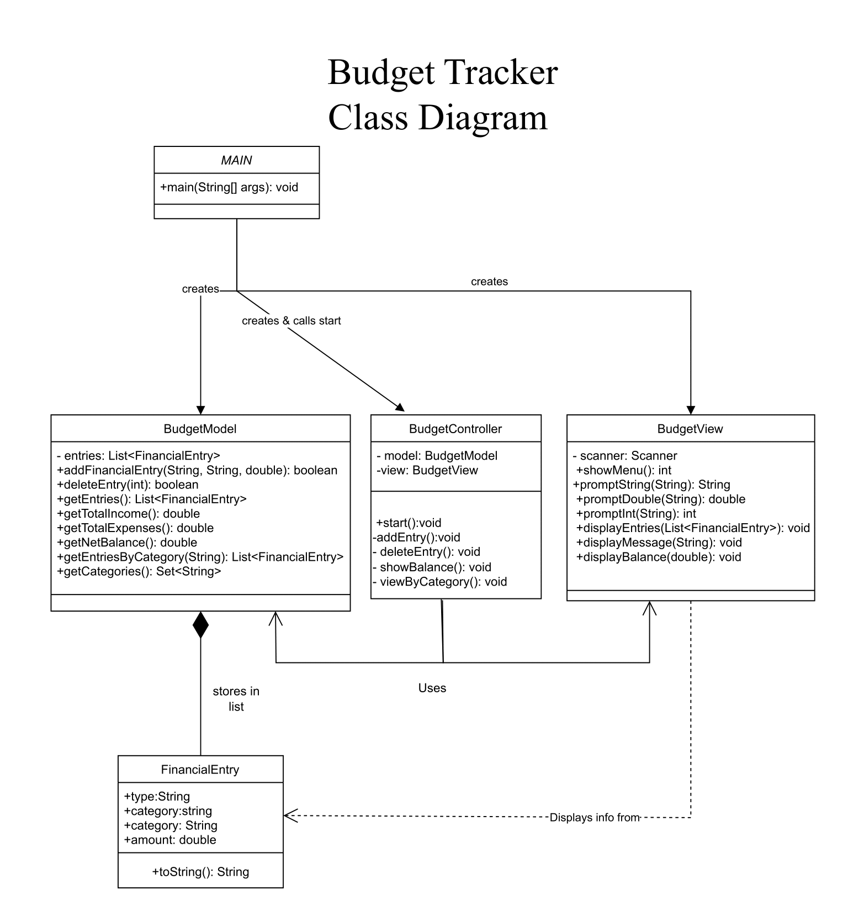
Solution 1
Application Design
Model: Add/edit/delete entries, categorize, calculate totals, validate inputs
View: Console menus, show balance & transactions
Controller: Handle user commands, route model ↔ view
Testing: Unit tests for validation & calculations, boundary/equivalence tests
Analysis
Strengths: Simple, fast build, solid core logic, good unit-test coverage
Limitations: Console UI only, limited automated/end-to-end testing
Not Chosen: Good foundation but lacks scalable UI & testability

Slide 8
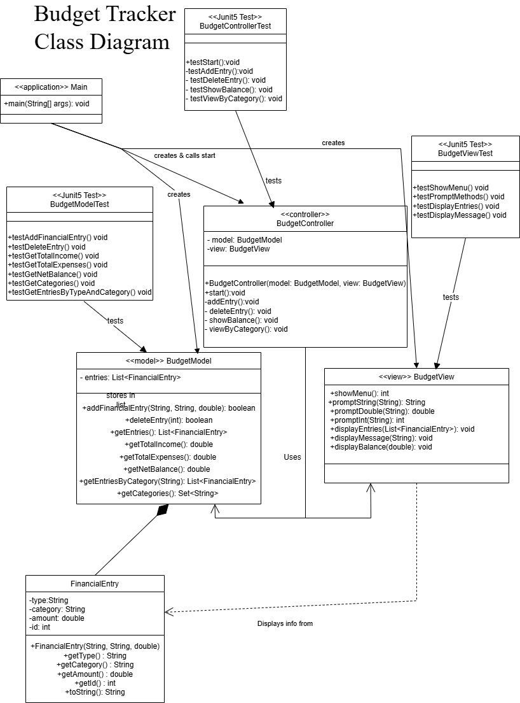
Solution 2
Application Design
Model: Persistent storage (CSV/SQLite), category totals, filters
View: Category summaries, simple charts, filter prompts
Controller: Load/save data, pass filters & summaries
Testing: Integration, path & use case testing
Analysis
Strengths: Adds persistence, richer insights
Limitations: Weak input validation, tight model–view coupling, console I/O dependency
Not Chosen: Scalability issues, poor testability, design flaws in separation of concerns

Slide 9
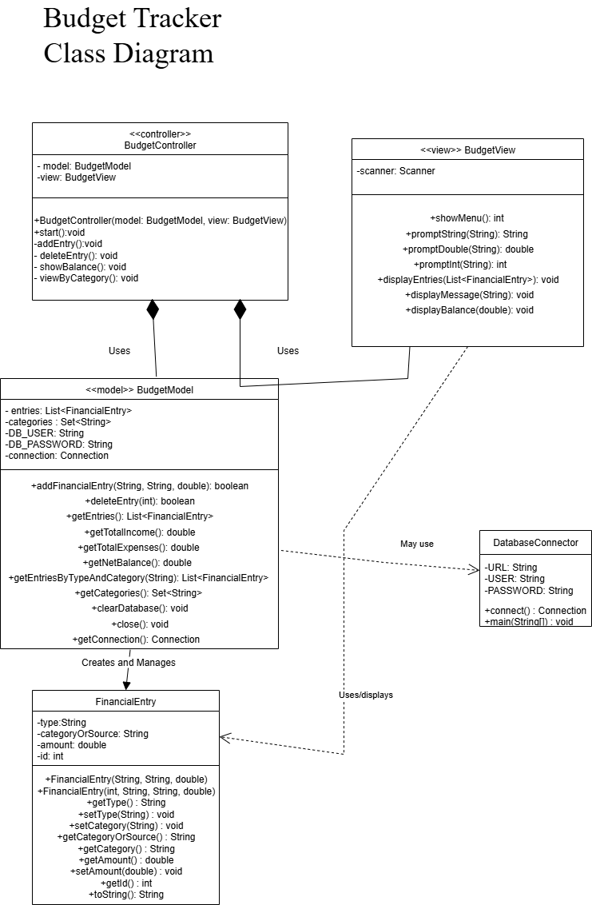
Solution 3
Application Design
Model: Uses MySQL (via JDBC), clean DB logic, scalable storage
View: Clear separation, supports richer UI options
Controller: Mediates without DB boilerplate, cleaner interactions
Testing: Easier DB testing, error handling, consistent connections
Analysis
Strengths: Scalable, maintainable, improved testability, clean architecture
Why Chosen: Fixes issues of prototypes, better error catching, supports long-term growth

Slide 10
Solution Comparison Table
Feature | Prototype 1 | Prototype 2 | Final Solution
Entry Handling | Basic | With filters | With filters + persistence
Data Storage | In-memory | File / CSV | MySQL via JDBC
Visualization | Console-based | Basic (text charts) | Console, expandable to GUI
Architecture | Basic MVC | Improved MVC | Full modular MVC
Testing Support | Unit + BVA + ECT | Integration + Path | Full suite of testing
Scalability | Low | Moderate | High

Slide 11
Boundary Value Analysis (BVA) (more details in TESTING.md)
Test Requirements
Validate amount bounds: [0 … 9 999], reject negatives and >9 999.
Enforce valid categories/types; case-sensitive inputs.
Test Cases
Amount: −1 (reject), 0 (accept), 1 (accept), 9 998 (accept), 9 999 (accept), 10 000 (reject).
Types/Categories at edges and invalids (e.g., job, EXPENSE, Luxury, utilities).
Testing Results
Valid boundary values accepted; out‑of‑range/invalid types/categories rejected as expected; confirms robust validation around monetary limits.

Slide 12
Equivalence Class Testing (ECT) (more details in TESTING.md)
Test Requirements
Partition inputs into valid/invalid classes for Type, Category/Source, Amount; accept one representative per valid class; reject invalid classes.
Test Cases
Valid: (income,income,800), (expense,food,150), (expense,healthcare,700).
Invalid: (INCOME, ,3000), (123,CAR,10000), (income,income,-50), (expense,98,500).
Testing Results
All valid class reps accepted; all invalid class reps rejected; confirms correctness without exhaustive enumeration.

Slide 13
Decision Table Testing (more details in TESTING.md)
Test Requirements
Derive rules from combined conditions (e.g., type/category/amount validity) and verify corresponding actions (accept, reject, show error).
Test Cases
Execute representative rules (Rule1–Rule7) to trigger mapped actions (A1–A6).
Verify each condition combination activates the correct action.
Testing Results
Each rule fired the expected action; no contradictory or missing rules observed; decision logic is consistent.

Slide 14
Path Testing (more details in TESTING.md)
Test Requirements
Cover independent paths through controller flows (e.g., add/view/delete, error branches).
Ensure each unique path is reachable and terminates correctly.
Test Cases
Controller path tests for: successful add → save; invalid input → error; view listing when data present/absent; delete success/error.
Use implementation harness (BudgetController_PathTesting.java).
Testing Results
All intended paths executed; error branches handled with clear messages; no dead paths detected.

Slide 15
Data Flow Testing (more details in TESTING.md)
Test Requirements
Validate correct definition–use (DU) chains for financial entries across controller→model→DB and back; detect anomalies (undef‑use, def‑kill).
Test Cases
Trace data from input → validation → persistence → retrieval → view; inject invalid types/categories to ensure no stale/undef data propagates.
Use BudgetController_DataFlowTesting.java.
Testing Results
DU chains consistent; invalid inputs blocked before persistence; no uses of undefined or killed variables observed.

Slide 16
Integration Testing (more details in TESTING.md)
Test Requirements
Verify end‑to‑end interaction: View ↔ Controller ↔ Model ↔ MySQL (JDBC); ensure load/save and filtered queries behave consistently.
Test Cases
Add entries → persist → list/filter by category/month → compute balance → delete → re‑query.
Include setup for DB connection as per project instructions.
Testing Results
Cross‑layer flows succeeded; persistence and retrieval matched; filters returned correct subsets; no connection leakage (replaced duplicate connections).

Slide 17
State Transition Testing (more details in TESTING.md)
Test Requirements
Model state changes: {Empty → Populated → Updated/Deleted} with guards (validations); ensure illegal transitions (e.g., delete non‑existent) handled.
Test Cases
Empty DB: view → “no entries”; Add → Populated; Update amount/category; Delete valid/invalid ID; Recompute balance after each transition.
Implemented in BudgetModel_StateTransistionTest.java.
Testing Results
Legal transitions applied; illegal attempts produced errors without altering state; balances stayed consistent after transitions.

Slide 18
Use Case Testing (more details in TESTING.md)
Test Requirements
Validate primary scenarios UC1–UC5 (add entry, view all, delete, view balance, view by category), including extensions/errors.
Test Cases
UC1 addEntry success and 3a/5a errors; UC2 viewAllEntries (with/without data); UC3 deleteEntry success and invalid ID/type; UC4 view balance calc; UC5 view by category with not‑found.
Implemented in BudgetModelUseCaseTest.java.
Testing Results
All main success paths pass; extension paths show correct error messages; balances and filters align with stored data.

Slide 19
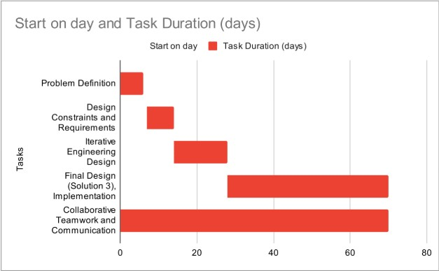
Project Management
Gantt Chart – Project Progress
Problem Definition – started Day 0, lasted ~5 days
Design Constraints & Requirements – started Day 5, lasted ~10 days
Iterative Engineering Design – started Day 15, lasted ~15 days
Final Design & Implementation (Solution 3) – started Day 28, lasted ~45 days
Collaborative Teamwork & Communication – ongoing across the full 70-day timeline
Summary: The chart shows a sequential build-up of tasks, from defining the problem to implementing the final solution, with collaboration continuing throughout the entire project.

Slide 20
Conclusion and Future Work
In this project, we successfully developed a fully functional Budjet Tracker Application that allows suers to manage their finances with ease. The system was made with a modular architecture using the MVC design pattern, and integrates a MySQL database as storage. Key features include:
Adding, viewing, filtering, and deleting financial entries (both income and expenses).
Providing summarized financial data, such as total income, total expenses, and net balance.
Supporting category-based filtering to help users track spending habits.
Interactive console-based user interface for intuitive usage.
Reliable database connectivity through a dedicated DatabaseConnector class. All features were tested to ensure reliability of each component.
Future Work:
Despite numerous successes, some limitations to the applicatiion still need to be implemented.
Console-based UI, adding user login system and dynamic categories.

